Slide 1



PHARMA DATA ANALYSIS
Presentation By:
Amrit Kumar

Slide 2
Introduction:
The dataset provided contains information related to sales transactions, including details such as distributor, customer name, location, product information, sales quantity, price, sales amount, and other relevant attributes. This data is crucial for understanding sales performance, customer behavior, market trends, and optimizing sales strategies.
Objectives:
The objective of analyzing this dataset is to gain actionable insights and make informed decisions to improve sales effectiveness, optimize resource allocation, and enhance customer satisfaction.

Slide 3
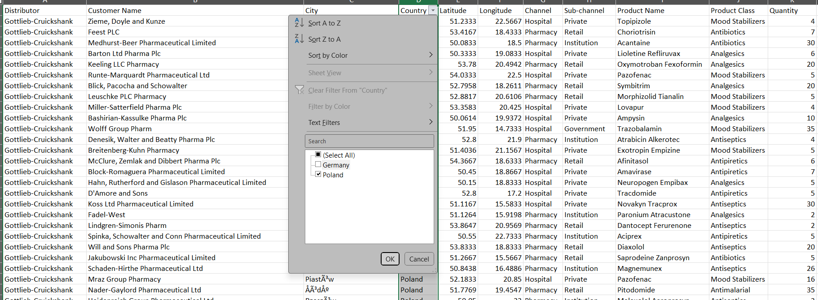
1. Basic Filtering: Can you filter the data to show only the records for a specific country,
let’s say "Poland"?

Slide 4
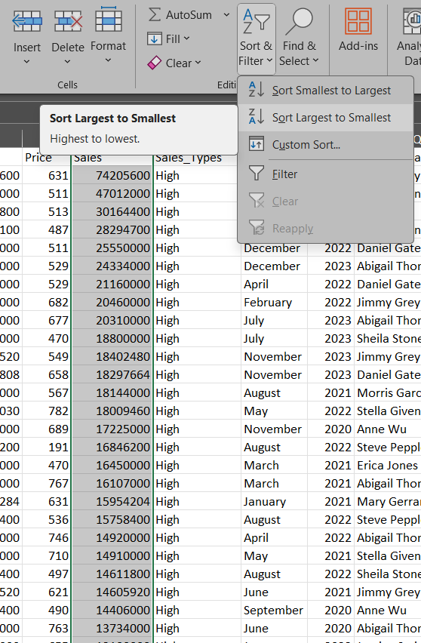
2. Sorting Data: How would you sort the data in ascending order based on the "Sales“ column?

Slide 5
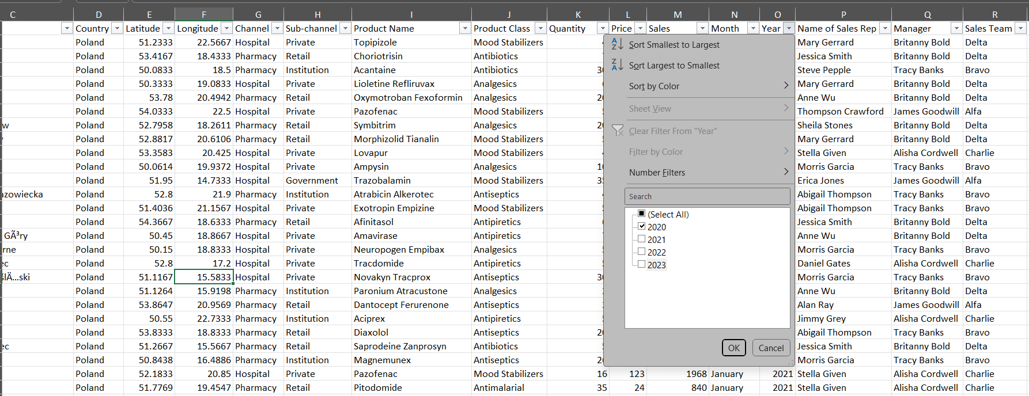
3. Summarizing Data: What is the total quantity of all products sold in the year 2023?

Slide 6
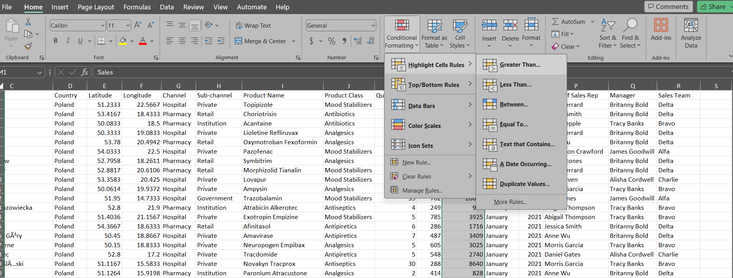
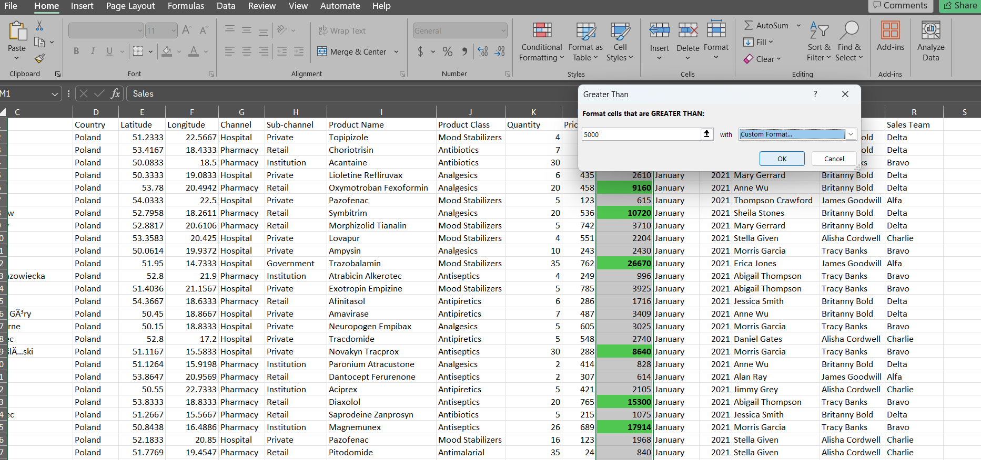
4. Conditional Formatting: Apply conditional formatting to highlight all sales greater than $5,000 in the "Sales" column.

Slide 7
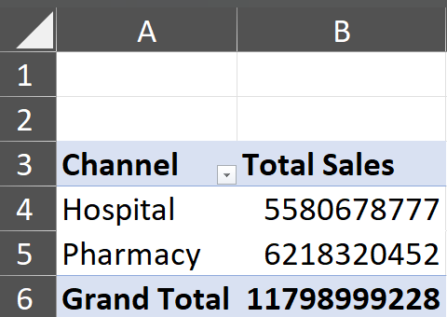
5. Simple Pivot Table: Create a pivot table to summarize total sales by "Channel."

Slide 8
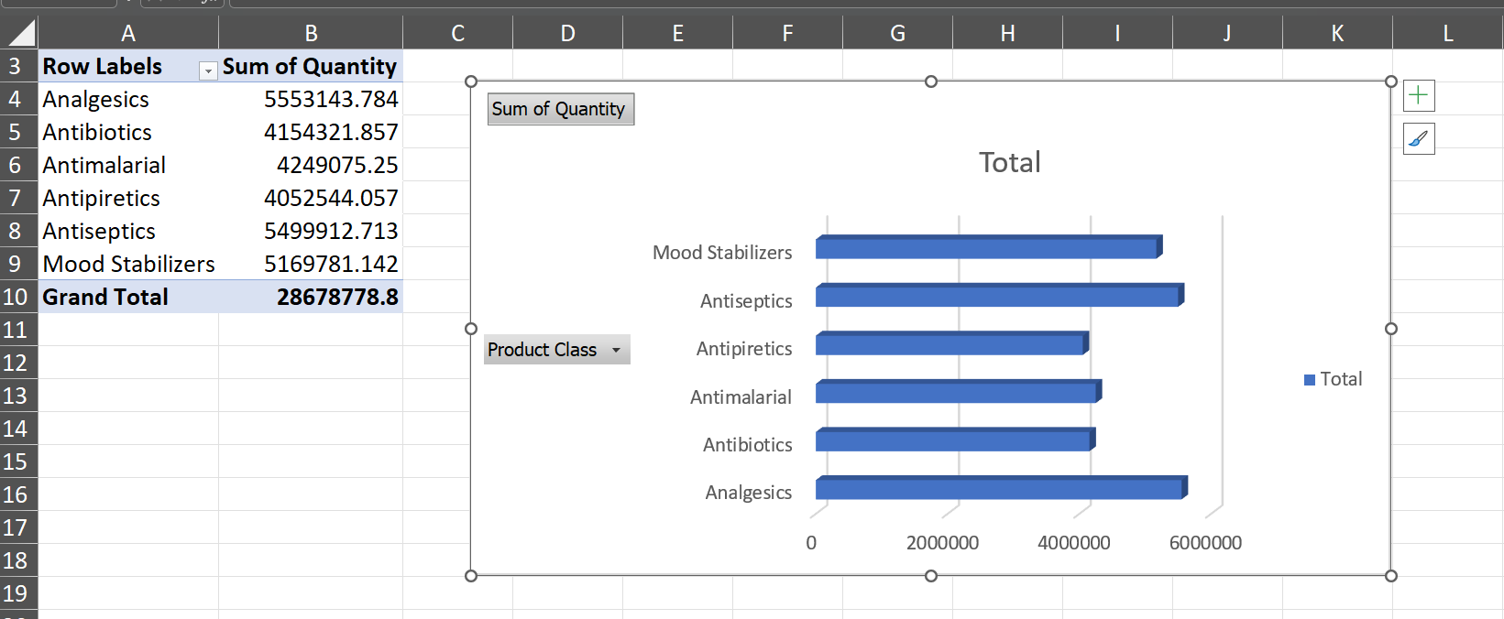
6. Basic Chart: Generate a bar chart to visualize the sales quantity by "Product Class."

Slide 9
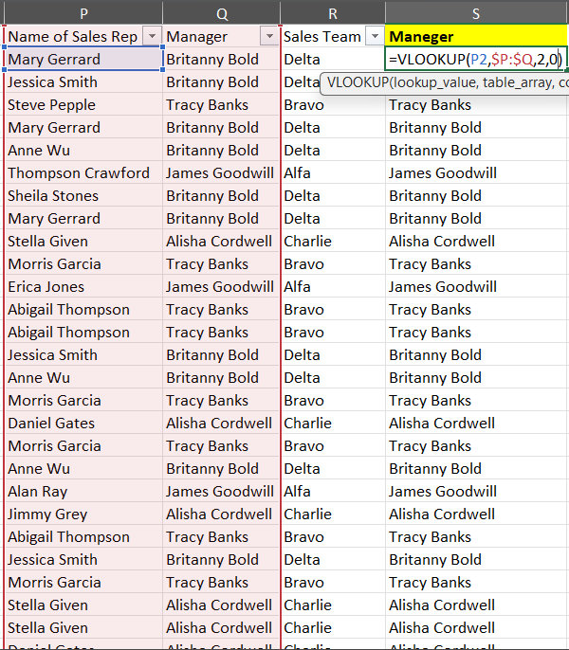
7. VLOOKUP Function: Can you use the VLOOKUP function to find the "Manager" for a specific "Sales Rep"?

Slide 10
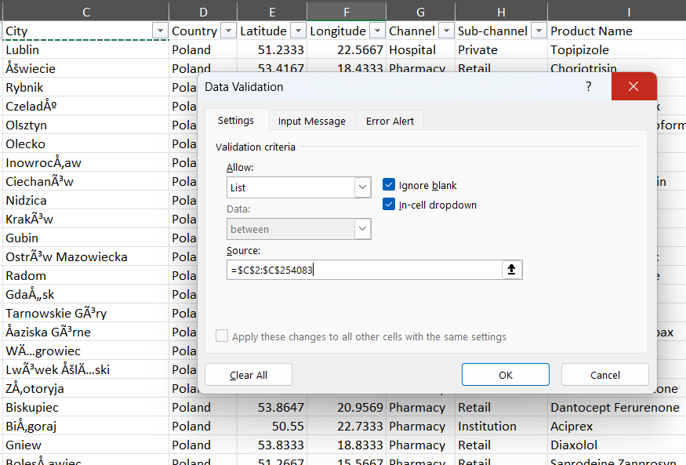
8. Data Validation: Set up data validation to allow only specific cities from a predefined list in the "City" column.

Slide 11
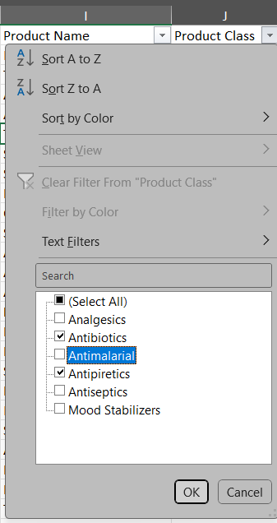
9. Advanced Filtering: Apply a filter to show records where "Product Class" is either
“Antibiotics" or “Antipiretics."

Slide 12
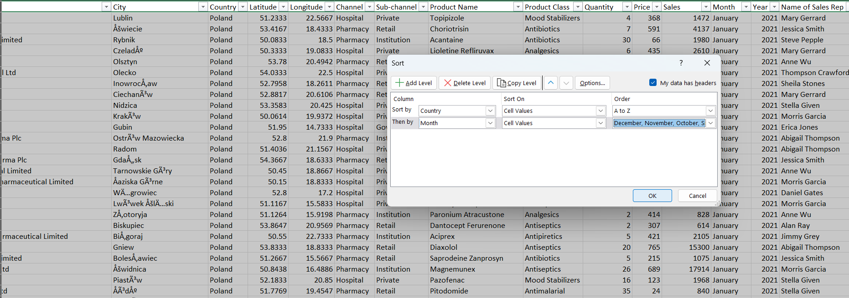
10. Sorting with Multiple Criteria: How would you sort the data first by "Country" in
ascending order, and then by "Month" in descending order?

Slide 13
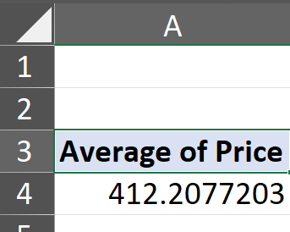
11. Calculated Fields in Pivot Table: Add a calculated field in the pivot table to calculate the average price per unit sold.

Slide 14
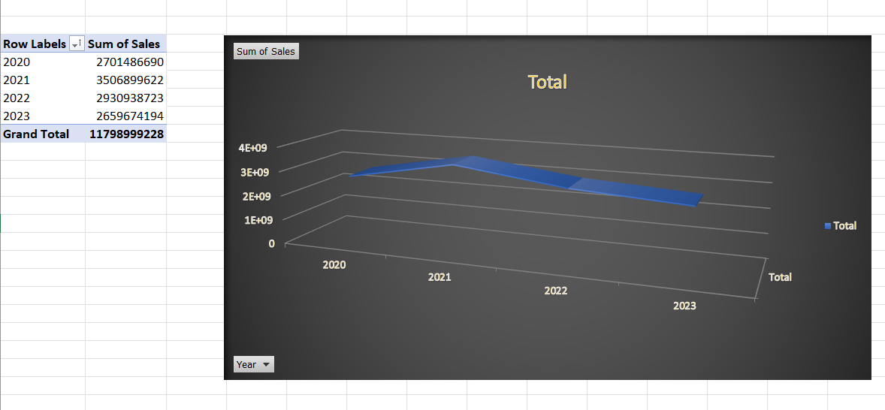
12. Advanced Charting: Create a line chart to show the trend of total sales over the years.

Slide 15
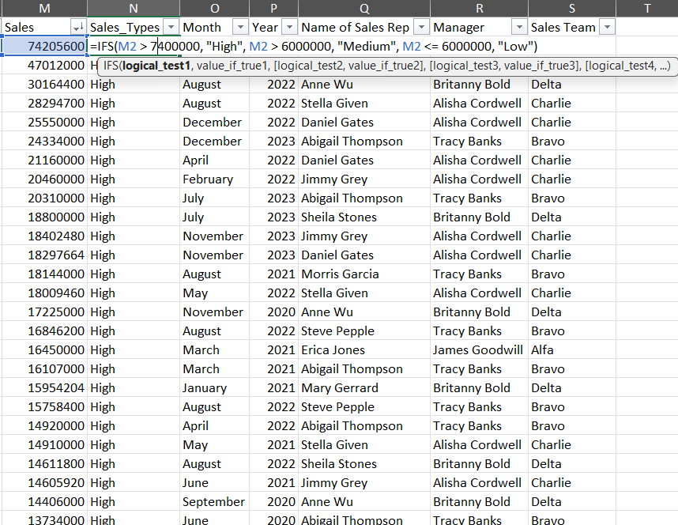
13. Nested IF Function: Use a nested IF function to categorize "Sales" into three categories: Low, Medium, and High.

Slide 16
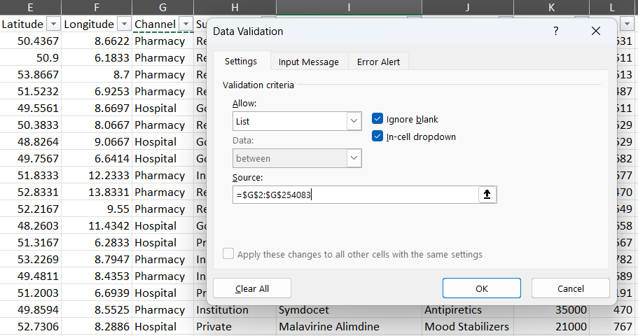
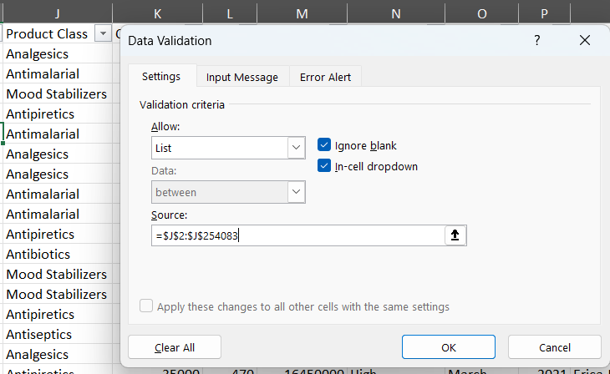
14. Data Validation with Dropdown Lists: Create dropdown lists for "Product Class" and
"Sub-channel" in the data entry cells.

Slide 17
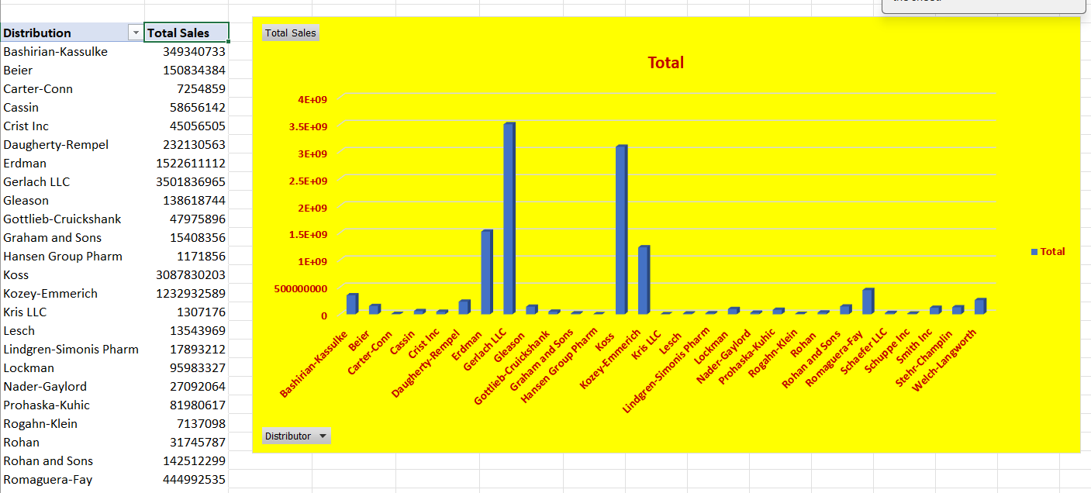
15. Pivot Chart: Turn the pivot table created earlier into a pivot chart to visualize sales by
"Distributor."

Slide 18
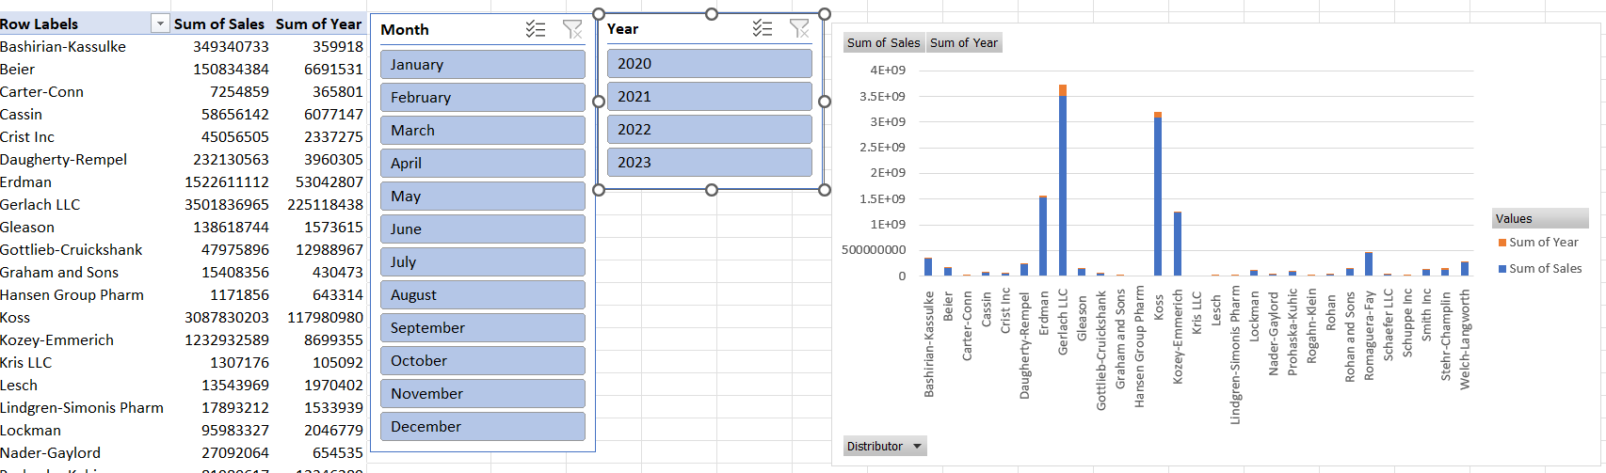
16. Pivot Table Slicers: Add slicers to the pivot table to allow easy filtering by "Month" and "Year."

Slide 19
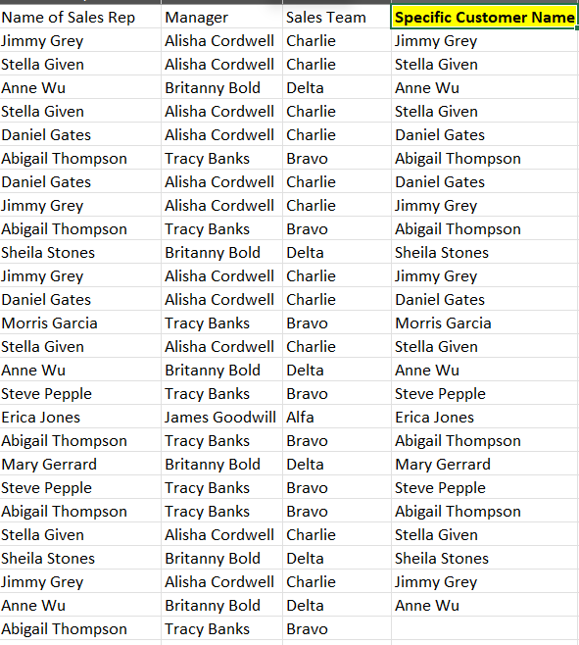
17. Lookup Functions: Use INDEX and MATCH functions to find the "Sales Rep" for a specific "Customer Name."
=INDEX(A2:A254083,MATCH(B2,B2:B254083,0))

Slide 20
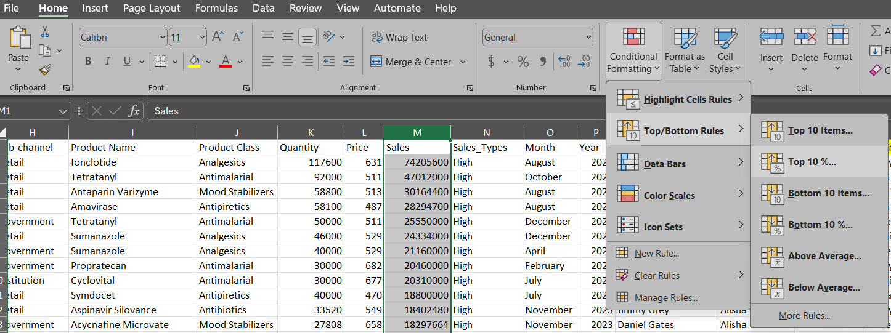
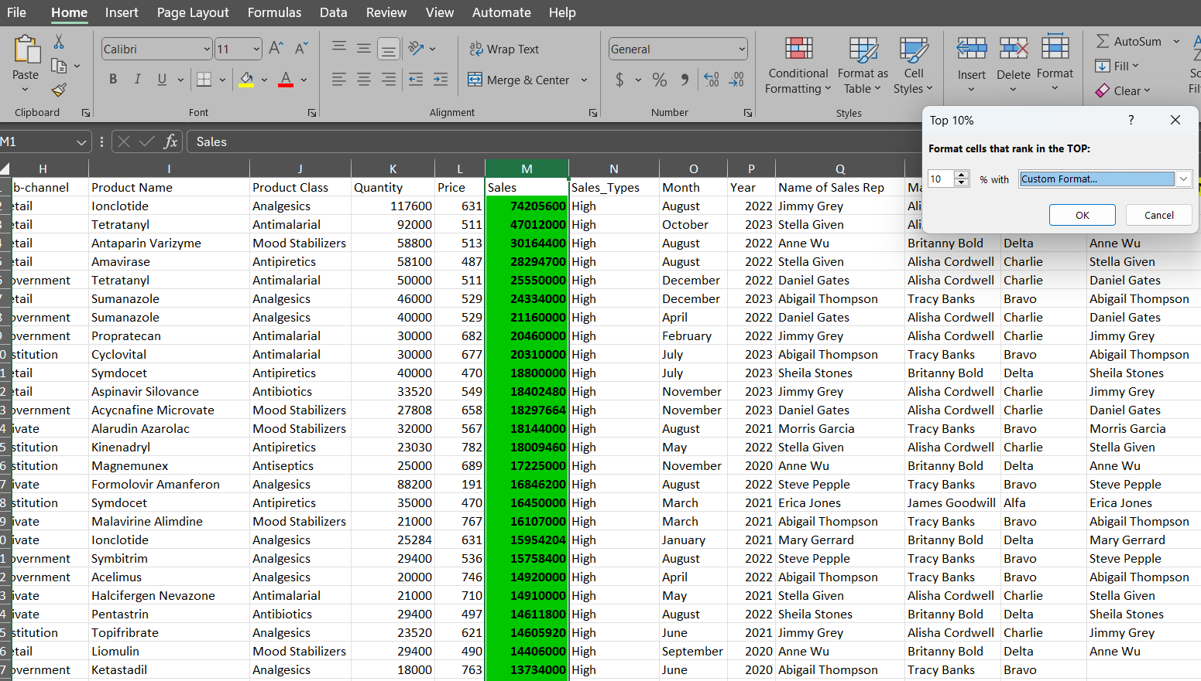
18. Advanced Conditional Formatting: Apply a custom conditional format to highlight the top 10% of sales values with a distinct color.

Slide 21
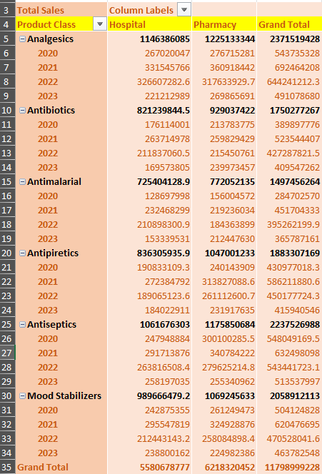
19. Data Consolidation: Consolidate data from multiple files into a single master file and
create a pivot table to summarize the combined data.

Slide 22
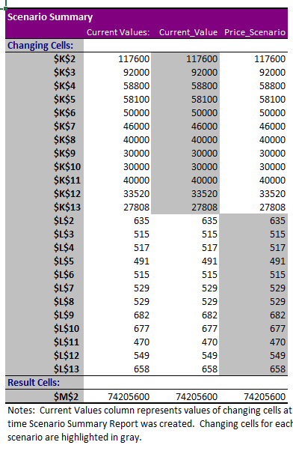
20. Scenario Manager: Use the Scenario Manager to compare different scenarios for future sales by changing variables like "Price" and "Quantity."

Slide 23


THANK YOU!
Amrit Kumar

